Slide 1
Strongly connected components

Slide 2
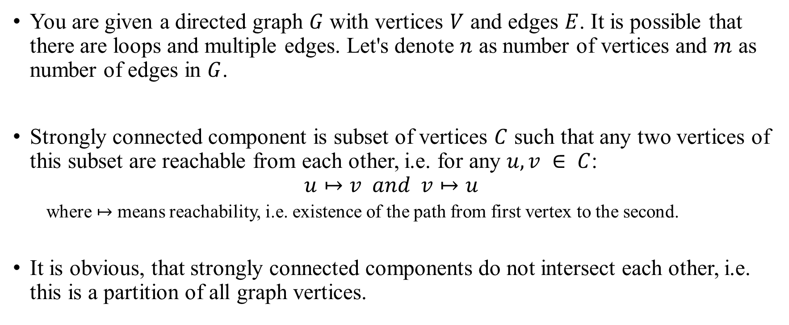
Strongly connected components
You are given a directed graph $G$ with vertices $V$ and edges $E$. It is possible that there are loops and multiple edges. Let's denote $n$ as number of vertices and $m$ as number of edges in $G$.
Strongly connected component is subset of vertices $C$ such that any two vertices of this subset are reachable from each other, i.e. for any $u, v ∈ C$:
$$u↦v and v↦u$$
where $↦$ means reachability, i.e. existence of the path from first vertex to the second.
It is obvious, that strongly connected components do not intersect each other, i.e. this is a partition of all graph vertices.

Slide 3
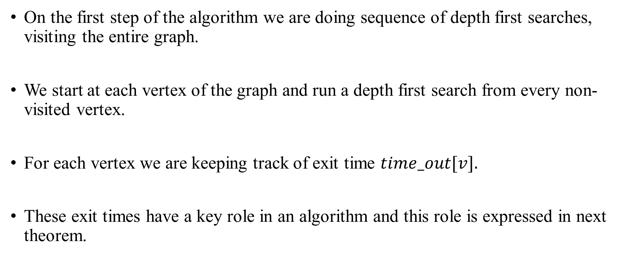
Strongly connected components Algorithm
On the first step of the algorithm we are doing sequence of depth first searches, visiting the entire graph.
We start at each vertex of the graph and run a depth first search from every non-visited vertex.
For each vertex we are keeping track of exit time $time_out[v].$
These exit times have a key role in an algorithm and this role is expressed in next theorem.

Slide 4

Strongly connected components Algorithm
First, let's make notations: let's define exit time $time_out[C]$ from the strongly connected component C as maximum of values $time_out[v]$ by all $v∈C$.

Slide 5
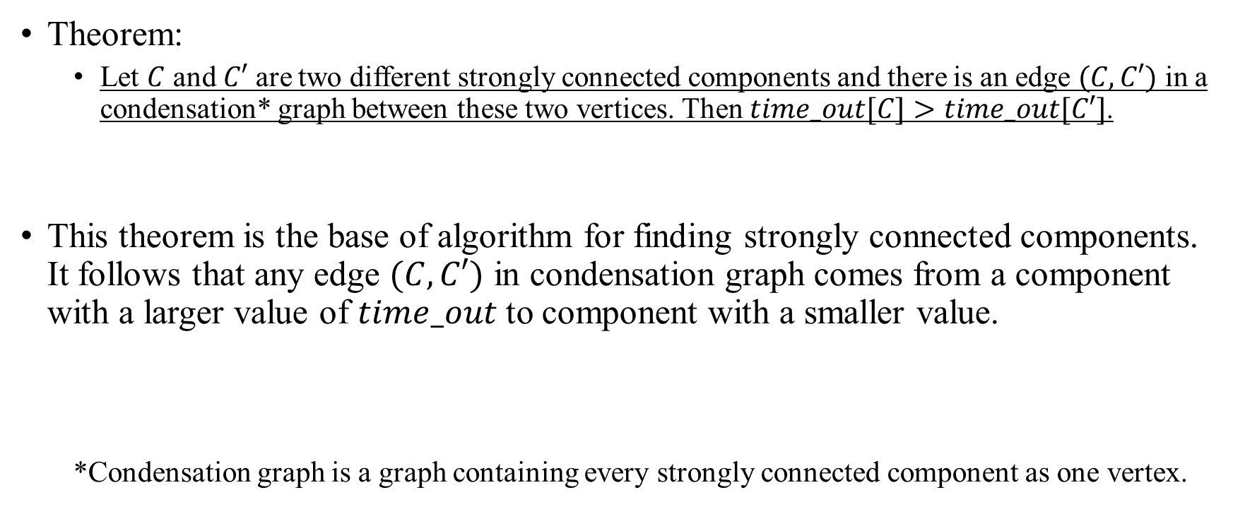
Strongly connected components Algorithm
Theorem:
Let $C$ and $C′$ are two different strongly connected components and there is an edge $(C,C′)$ in a condensation* graph between these two vertices. Then $time_out[C]>time_out[C′]$.
This theorem is the base of algorithm for finding strongly connected components. It follows that any edge $(C,C′)$ in condensation graph comes from a component with a larger value of $time_out$ to component with a smaller value.
*Condensation graph is a graph containing every strongly connected component as one vertex.

Slide 6
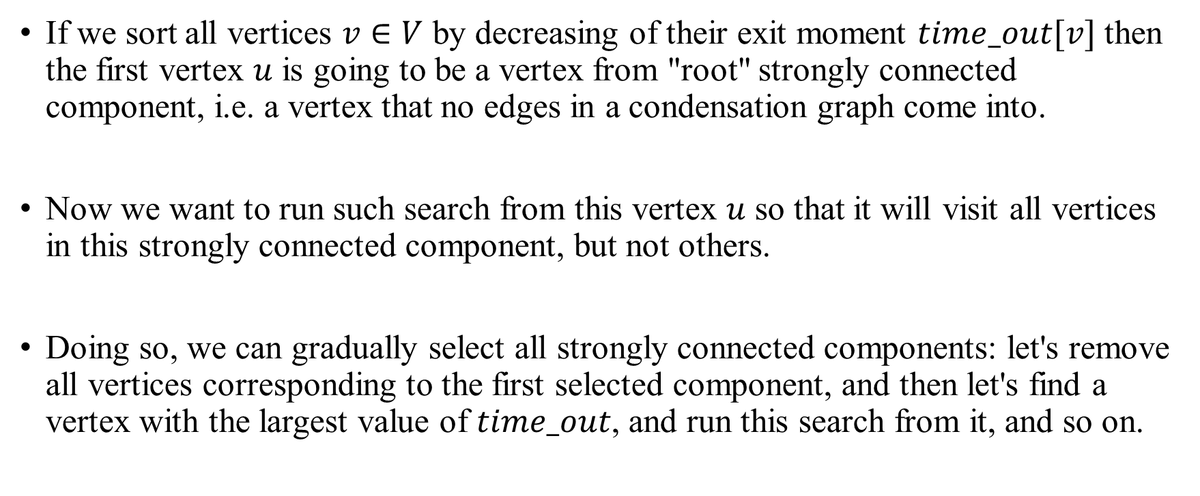
Strongly connected components Algorithm
If we sort all vertices $v∈V$ by decreasing of their exit moment $time_out[v]$ then the first vertex $u$ is going to be a vertex from "root" strongly connected component, i.e. a vertex that no edges in a condensation graph come into.
Now we want to run such search from this vertex $u$ so that it will visit all vertices in this strongly connected component, but not others.
Doing so, we can gradually select all strongly connected components: let's remove all vertices corresponding to the first selected component, and then let's find a vertex with the largest value of $time_out$, and run this search from it, and so on.

Slide 7
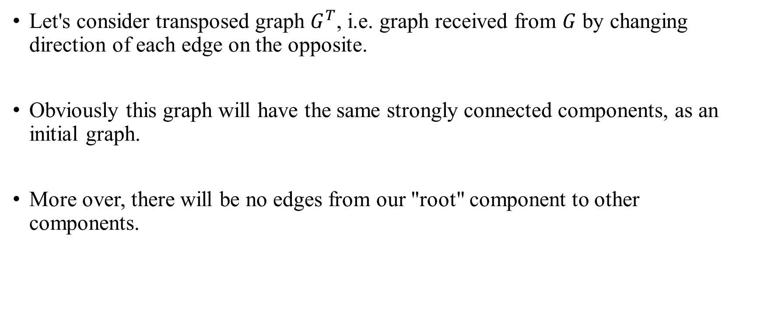
Strongly connected components Algorithm
Let's consider transposed graph $G^{T}$, i.e. graph received from $G$ by changing direction of each edge on the opposite.
Obviously this graph will have the same strongly connected components, as an initial graph.
More over, there will be no edges from our "root" component to other components.

Slide 8
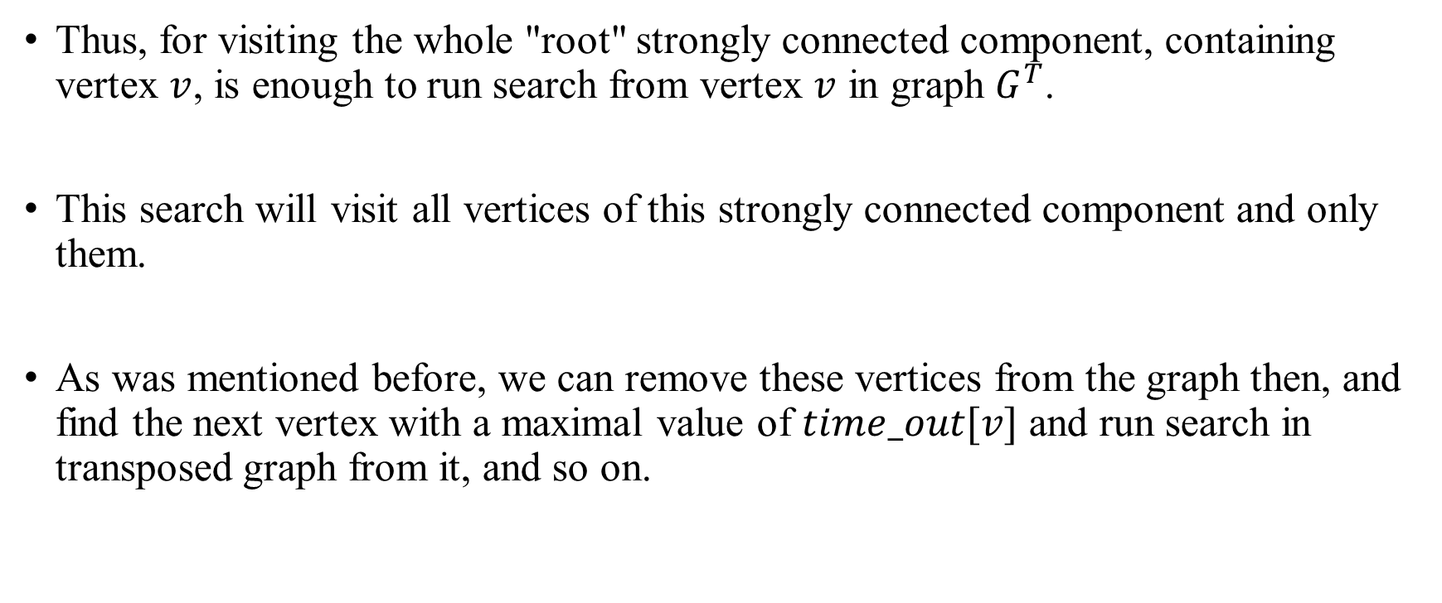
Strongly connected components Algorithm
Thus, for visiting the whole "root" strongly connected component, containing vertex $v$, is enough to run search from vertex $v$ in graph $G^{T}$.
This search will visit all vertices of this strongly connected component and only them.
As was mentioned before, we can remove these vertices from the graph then, and find the next vertex with a maximal value of $time_out[v]$ and run search in transposed graph from it, and so on.

Slide 9
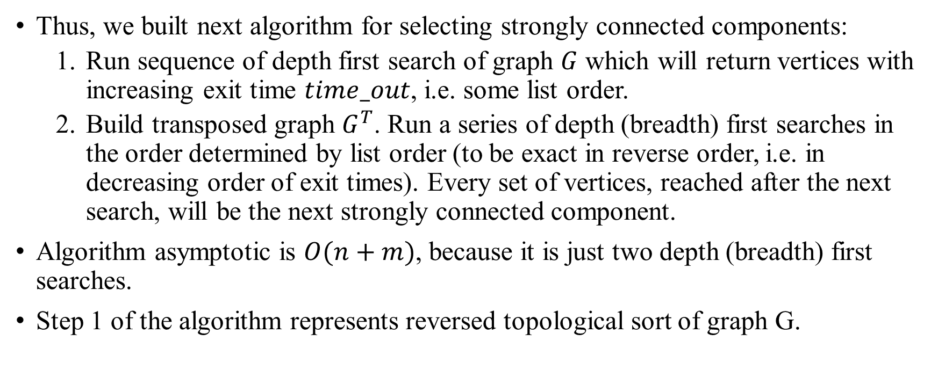
Strongly connected components Algorithm
Thus, we built next algorithm for selecting strongly connected components:
Run sequence of depth first search of graph $G$ which will return vertices with increasing exit time $time_out$, i.e. some list order.
Build transposed graph $G^{T}$. Run a series of depth (breadth) first searches in the order determined by list order (to be exact in reverse order, i.e. in decreasing order of exit times). Every set of vertices, reached after the next search, will be the next strongly connected component.
Algorithm asymptotic is $O(n+m)$, because it is just two depth (breadth) first searches.
Step 1 of the algorithm represents reversed topological sort of graph G.

